Slide 1
Revisioning the Three R’s: Relationships, Resilience and Resources
Dr. Ann Kajander & Taylor Murie, Lakehead University
Fields Institute MathEd Forum 2019
January 25, 2019

Slide 2
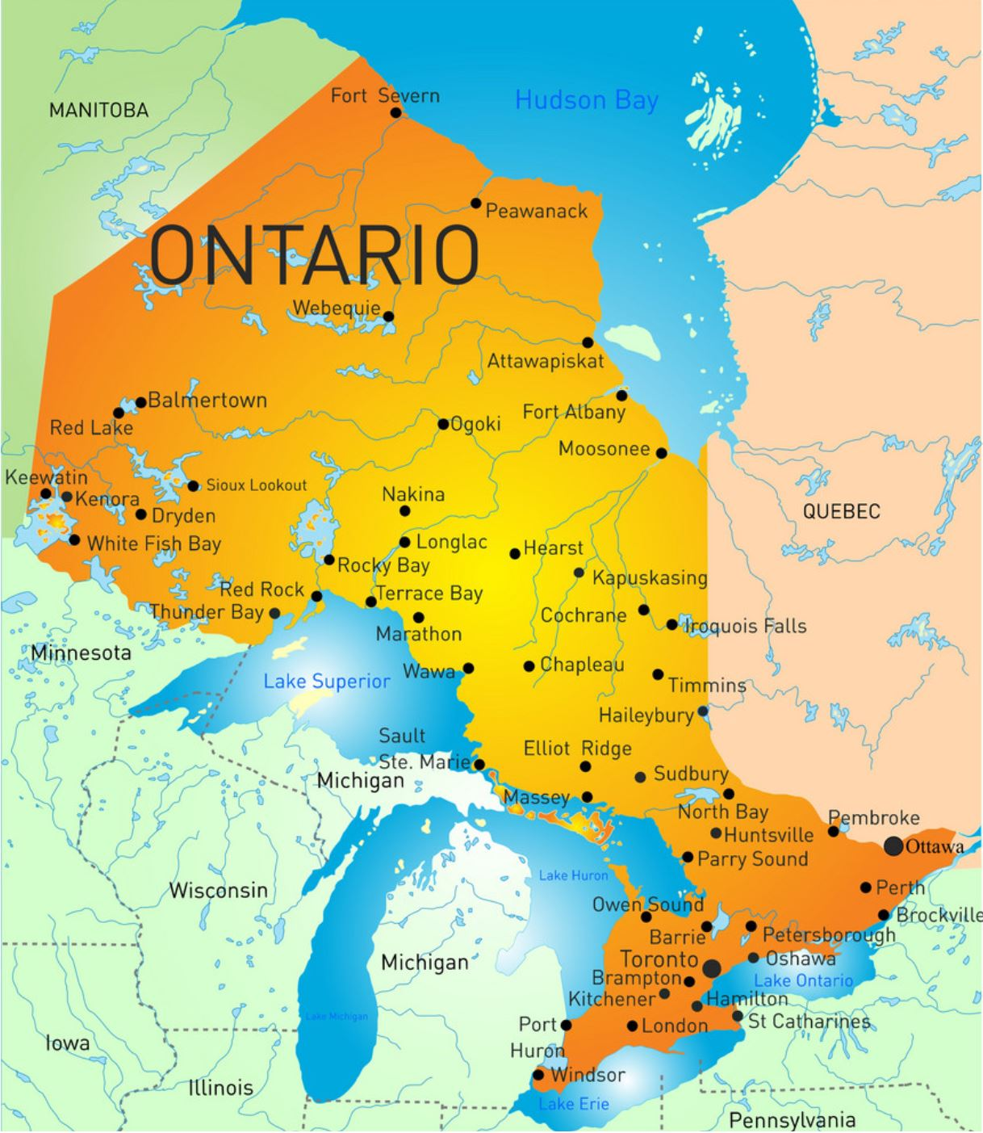
Education in Northwestern Ontario
41.3% of Thunder Bay students met the provincial standard in Grade 9 Applied mathematics (provincial average is 46%).
Locally Developed mathematics enrolment is larger than the provincial average.
Deer Lake
Eabametoong (Fort Hope)
Whitesand
Government of Ontario. (2018, December). School information and student demographics. Retrieved from https://www.ontario.ca/data/school-information-and-student-demographics
Vector Stock. (n.d.). Ontario province map [Map]. Retrieved from https://www.vectorstock.com/royalty-free-vector/ontario-province-map-vector-2934869
Notes:
Thunder Bay is also considered “the hub” and access point of the north. Many communities flock to Thunder Bay in times of need of to get access to resources

Slide 3
Factors Influencing Education in the North
CBC News: The National. (2017, November 13). First Nations families weigh children’s education vs. safety [Video file]. Retrieved from https://www.youtube.com/watch?v=x9iTBSPSE3U
Notes:
We have a context that doesn’t translate well to a curriculum document description. Here it is.
First Nations youth leaving home communities
Stigma
Isolation
Child poverty
Thunder Bay was host to the 2016 inquest nationwide into the deaths of 7 First Nations youth who had left their home communities to come here for high school.
In 2018, the Thunder Bay Police Service was investigated for racism and discrimination against Indigenous peoples. The report found systemic racism throughout the police force and provided recommendations for the police.
Child poverty in Thunder Bay has reached 21%, which is higher than the national average of 17.4%

Slide 4
Factors Influencing Education in the North
CBC News: The National. (2017, November 13). First Nations families weigh children’s education vs. safety [Video file]. Retrieved from https://www.youtube.com/watch?v=x9iTBSPSE3U

Slide 5
Locally Developed Mathematics (LDM)
Implications of lack of provincial testing
Individualized curriculum(?)
Minimal resources available
Larger range of student abilities than in any other course
Students face difficult external factors
Notes:
Vast majority number of student like the one shown in the video end up here
2 implications of lack of standardized testing
1) teachers don’t have time to make resources or individualize the curriculum (such a wide range of levels)
2) No funding

Slide 6
General Learning Strategies (GLS) Transitions
Pilot project on recommendation of one school’s department head
The goal is closing literacy and numeracy gaps for students transitioning to Grade 9
Focus on social and behavioural aspects of high school
Acts as a safe space for those who would like to pursue an Applied or LDM credit, but are overwhelmed by the classroom environment
Course starts with 0 enrolment, and teacher invites those students who need this space
Runs at the same time as Grade 9 LDM, Applied and Academic classes so possible transfer is easy
Notes:
Real brain child and labour of love a very committed department head at the school
Emotional energy required on the teacher’s end

Slide 7
Research Context
We have been developing relationships with students and teachers for 2 years.
Estimated total of classroom observation and participation hours: 230
Observed and participated in 3 Grade 9 LDM courses and 2 GLS courses amongst 3 researchers, at least on a weekly basis
BACP. (n.d.). Research resources [Image]. Retrieved from https://www.bacp.co.uk/events-and-resources/research/
Notes:
Number of hours reflects complexity and resource design
Willing to invest in the classroom and be there in order to understand the group you are dealing with
Overall observations of caring and food, etc. welcoming nature. Sitting with students in the hall.
You cannot in this context is to be a participant in the classroom. We have to be participant observers, not just inactive observers. Have to be involved with the students on a personal level.

Slide 8
Research Questions
1. How can teachers be better supported to deliver the Grade 9 Locally Developed and transitions courses to these high needs students?
2. How do student needs align or differ with those in other mathematics courses?
3. Does the introduction of Indigenized and decolonized mathematics content increase student engagement in these courses, and if so, how?
Notes:
Through researching these questions, we have developed three key themes – relationships, resilience and resources. Mention the mandate of the ministry….relationships
The research is still in progress though. Explain my focus

Slide 9
Relationships
Teacher-student relationships are critical to success in Grade 9 LDM
“[Relationships are] very important, I think that’s half of it. If the kids know that you truly care about them and you want their best interest then the kids will be more willing to do things for you, they’ll feel comfortable with you. You don’t realize what impact you’re having on them at the time and sometimes you’re like “I don’t feel like I’m doing anything”. But sometimes after the fact… when you have conversations with them after and they come up to you or—because it’s hard to really reflect while you’re in the moment if you have made a difference” (Interview 2: Janice)
IconFinder. (n.d.). Account, add, business, connection, file, link, network, icon [Image]. Retrieved from https://www.iconfinder.com/icons/327729/account_add_business_connection_file_link_network_icon
Notes:
Connects back to RQ2
Of the the three subgroups, this is the most fundamentally important
Connects to developing a capacity of resilience as well
Jao model (more than one way to develop…modified (or similar to) inspired by (relationdhips within academic) – Ann will jump in

Slide 10
Resilience
“Resilience refers to the capacity to return to good mental health after challenging and difficult situations” (Hurlington, 2010, p.1).
“Well… realizing that in the end, the math is important but sometimes if it’s just getting them into the building, into the room and making them feel like it’s a good place… just trying to know that I care about them and I’ll help them in any way I can. I can’t change a lot of it but I can be a positive supportive person while they’re here at school” (Interview 2: Janice)
Hurlington, K. (2010, February). Bolstering resilience in students: Teachers as protective factors. What Works? Research Into Practice. Retrieved from http://www.edu.gov.on.ca/eng/literacynumeracy/inspire/research/WW_bolstering_students.pdf
Notes:
Being able to access resilience building and capacity, the relationship has to be in place.

Slide 11
Resource Development
Quality resources are important, but are not nearly enough.
“One massive, massive, massive thing is…more support in the classrooms. That’s desperately needed. One teacher is not enough. The teacher needs the support emotionally, mentally… and the students, we need support for more of our students. The way that support funding is right now, basically, you have to have a student that is behavioural. You could have an entire classroom full of IEPs and no one to help. And you’re just one person. That’s just with the IEPs. ” (Interview 2)

Slide 12
Our Resource Development Ideas
Notes:
Working on these on an ongoing basis, they are themes, ideas, not exhaustive, but a brainstorming cloud. The indigenizing piece is a part of it, but we wanted to create a variety of resources.

Slide 13
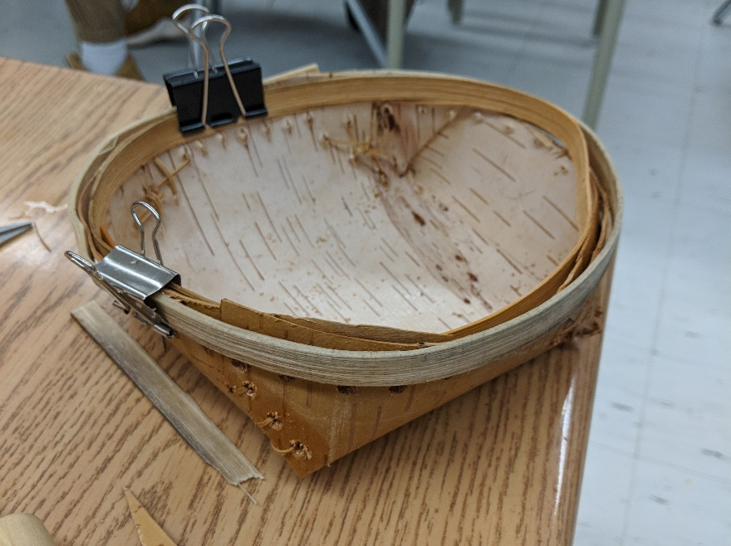
Resources
Birch bark basket making collaboration
Traditional travel workshop
Canada 150 Rubber Duck Task
Tim Horton’s Roll Up the Rim Task
Hockey rates and ratio task
Flyer shopping activity
Blue whale ratio lesson
Driveway paving learning & assessment tasks
Meyer, D. (n.d.). 3 Act Mathematics Tasks. Retrieved from: https://tapintoteenminds.com/3act-math/
Notes:
Connects back to RQ#1 & 3
All in various stages of development, some field tested, some are close to publishable, some early stages of development.

Slide 14
Conclusions
“The only take-away that is transferable, for these kids in these courses, is the relationships piece – without that you have nothing. And every day is different.” (department head interview)
Notes:
We can create wonderful resources, but without a teaching willing to make a genuine emotional investment, they are not going to work.

Slide 15
References
BACP. (n.d.). Research resources [Image]. Retrieved from https://www.bacp.co.uk/events-and-resources/research/
CBC News: The National. (2017, November 13). First Nations families weigh children’s education vs. safety [Video file]. Retrieved from https://www.youtube.com/watch?v=x9iTBSPSE3U
Government of Ontario. (2018, December). School information and student demographics. Retrieved from https://www.ontario.ca/data/school-information-and-student-demographics
Hurlington, K. (2010, February). Bolstering resilience in students: Teachers as protective factors. What Works? Research Into Practice. Retrieved from http://www.edu.gov.on.ca/eng/literacynumeracy/inspire/research/WW_bolstering_students.pdf
IconFinder. (n.d.). Account, add, business, connection, file, link, network, icon [Image]. Retrieved from https://www.iconfinder.com/icons/327729/account_add_business_connection_file_link_network_icon
Meyer, D. (n.d.). 3 Act Mathematics Tasks. Retrieved from: https://tapintoteenminds.com/3act-math/
Vector Stock. (n.d.). Ontario province map [Map]. Retrieved from https://www.vectorstock.com/royalty-free-vector/ontario-province-map-vector-2934869

Slide 16
Acknowledgements
Matthew Valley & Kelly Sedor
Dr. Joe Flessa, University of Toronto
SSHRC
Mathematics Knowledge Network
This research was supported by the Social Sciences and Humanities Research Council of Canada
The MKN is funded by the Ontario Ministry of Education. The MKN is a KNAER Project, hosted by the Fields Institute for Research in Mathematical Sciences. The views expressed in this presentation belong to the authors and do not necessarily reflect the opinions of the Ministry of Education nor the Ontario government.

